Slide 1




Variables, data types and expressions
Working with the console, arithmetic operations
Variables, data types
and expressions
SoftUni Team
Technical Trainers
Software University
http://softuni.bg

Slide 2
Have a Question?
sli.do 123321

Slide 3

Content
Variables and data types
Reading user input from the console
Basic operations
With text
With numbers
Writing to the console

Slide 4
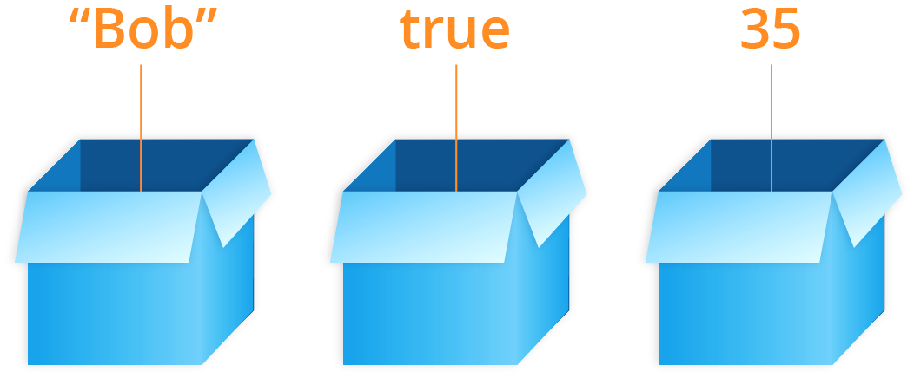
Variables and data types

Slide 5
Variables
Computers are machines which process data
Data is persisted in the computer memory in variables
Variables have name, type and value
Declaring a variable and assigning value:
After processing the data is again persisted in variables
Name of the variable
Declaration
var count = 5;
Value (of type number)

Slide 6
Data types
Variables store value of a certain type
Number, letter, text (string), date, color, picture, list, …
Data types – examples:
int - integer: 1, 2, 3, 4, 5, …
double – floating point number: 0.5, 3.14, -1.5, …
char - symbol: 'a', 'b', '#', …
string - text (string): "Здрасти", "Hi", "Banana", …
DateTime - date: 01-07-2017, 06/06/1997, …

Slide 7
Integer Types
sbyte [-128 …127]: signed 8-bit [-2⁷ … 2⁷-1]
byte [0 … 255]: unsigned 8-bit [0 … 2⁸-1]
short [-32 768 … 32 767]: signed 16-bit [-2¹⁵ … 2¹⁵-1]
ushort [0 … 65 535]: unsigned 16-bit [0 … 2¹⁶-1]
int [-2 147 483 648 … 2 147 483 647]: signed 32-bit [-2³¹ … 2³¹-1]
uint [0 … 4 294 967 295]: unsigned 32-bit [0 … 2³²-1]
long [-9 223 372 036 854 775 808 … 9 223 372 036 854 775 807]: signed 64-bit [-2⁶³ … 2⁶³-1]
ulong [0 … 18 446 744 073 709 551 615]: unsigned 64-bit [0 … 2⁶⁴-1]
byte
sbyte
uint
short
int
ushort
long
ulong

Slide 8

Centuries – Example
Depending on the unit of measure we can use different data types:
byte centuries = 20; // A small number (up to 255)
ushort years = 2000; // A small number (up to 32767)
uint days = 730484; // A large number (up to 4.3 billions)
ulong hours = 17531616; // A very big number (up to 18.4*10^18)

Slide 9
Beware of Integer Overflow!
Integers have range (minimal and maximal value)
Integers could overflow → this leads to incorrect values
byte counter = 0;
for (int i = 0; i < 260; i++)
{
counter++;
Console.WriteLine(counter);
}
1
2
…
255
0
1

Slide 10

Floating-Point Numbers
Floating-point types are:
float (±1.5 × 10⁻⁴⁵ to ±3.4 × 10³⁸)
32-bits, precision of 7 digits
double (±5.0 × 10⁻³²⁴ to ±1.7 × 10³⁰⁸)
64-bits, precision of 15-16 digits
The default value of floating-point types:
Is 0.0F for the float type
Is 0.0D for the double type
Is 0.0M for the decimal type
double
float

Slide 11

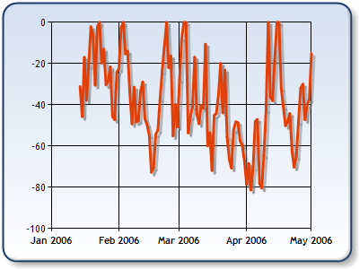
Decimal Floating-Point Type
There is a special decimal floating-point real number type in C#:
decimal (±1,0 × 10⁻²⁸ to ±7,9 × 10²⁸)
128-bits, precision of 28-29 digits
Used for financial calculations
Almost no round-off errors
Almost no loss of precision
The default value of decimal type is:
0.0M (M is the suffix for decimal numbers)
decimal
Notes:
Text goes to notes

Slide 12

Reading user input

Slide 13
Reading from the Console
The console understands only text (string).
Everything that we receive from the console comes as text (string)
Everything that we print on the console gets transformed into text (string)
Command for reading from the console:
Blocking command
Returns as text (string) the text read from the console.
Console.ReadLine();

Slide 14
Reading from the Console (2)
Reading text (string) from the console:
Example:
var str = Console.ReadLine();
var name = Console.ReadLine();
Console.WriteLine(name);
Ivan
Ivan
Georgi
Georgi

Slide 15
Reading an integer
Reading an integer:
Example: calculating the area of a square with side а:
var num = int.Parse(Console.ReadLine());
var a = int.Parse(Console.ReadLine());
var area = a * a;
Console.WriteLine(area);
4
16
20
400
Test your solution: https://judge.softuni.bg/Contests/852/Variables-Data-Types-Expressions

Slide 16
Reading a floating point number
Reading a floating point number from the console:
Example: converting from inches to cantimeters:
var num = double.Parse(Console.ReadLine());
var inches = double.Parse(Console.ReadLine());
var centimeters = inches * 2.54;
Console.WriteLine(centimeters);
3
7.62
10
25.4
Test your solution: https://judge.softuni.bg/Contests/852/Variables-Data-Types-Expressions

Slide 17
Simple operations
+
-
Manipulating text and numbers

Slide 18
Greeting by Name – Problem
Write a program which:
Reads from the console a name of a person and prints "Hello, <name>!", where <name> is an input from the user.
var name = Console.ReadLine();
Console.Write("Hello, ");
Console.WriteLine(name);
The cursor stays on the same row
Test your solution: https://judge.softuni.bg/Contests/852/Variables-Data-Types-Expressions

Slide 19
Concatenating text and a number
Concatenating text and a number (operator +):
The result is concatenation
var firstName = "Maria";
var lastName = "Ivanova";
var age = 19;
var str = firstName + " " + lastName + " @ " + age;
Console.WriteLine(str);
// Maria Ivanova @ 19
var a = 1.5;
var b = 2.5;
var sum = "The sum is: " + a + b;
Console.WriteLine(sum);
// The sum is 1.52.5

Slide 20
Arithmetic operations: + and -
Adding numbers (operator +):
Removing numbers (operator -):
var a = 5;
var b = 7;
var sum = a + b;
// 12
var a = int.Parse(Console.ReadLine());
var b = int.Parse(Console.ReadLine());
var result = a - b;
Console.WriteLine(result);

Slide 21
Arithmetic operations: * and /
Multiplying numbers (operator *):
Dividing numbers (operator /):
var a = 5;
var b = 7;
var product = a * b;
// 35
var a = 25;
var i = a / 4;
var f = a / 4.0;
var error = a / 0;
// 6 – the fractional part is cut
// 6.25 – fractional division
// Error: dividing by zero

Slide 22
Dividing numbers – features
When dividing integers the result is also an integer:
When dividing floating point numbers the result is also a floating point number:
var a = 25;
Console.WriteLine(a / 4);
Console.WriteLine(a / 0);
// Integer result: 6
// Error: dividing by zero
var a = 15;
Console.WriteLine(a / 2.0);
Console.WriteLine(a / 0.0);
Console.WriteLine(0.0 / 0.0);
// Fractional result: 7.5
// Result: Infinity
// Result : NaN

Slide 23
Expressions
We can use expressions to calculate a result:
Calculating trapezoid area:
var expr = (3 + 5) * (4 – 2);
var b1 = double.Parse(Console.ReadLine());
var b2 = double.Parse(Console.ReadLine());
var h = double.Parse(Console.ReadLine());
var area = (b1 + b2) * h / 2.0;
Console.WriteLine(area);
Test your solution: https://judge.softuni.bg/Contests/852/Variables-Data-Types-Expressions

Slide 24
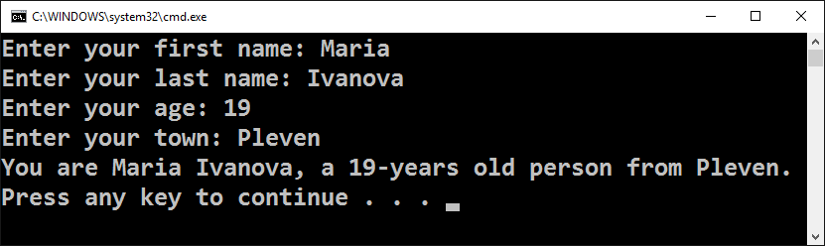
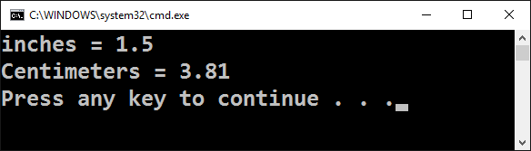
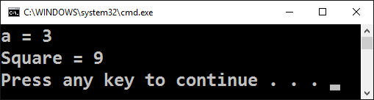
Tasks with simple calculations
Work live in class (lab)

Slide 25
Writing to the Console
{0}
${…}
Formatting the output

Slide 26
Concatenating text and numbers
When we write to the console we can concatenate text using the placeholders: {0}, {1}, {2}, …
var firstName = Console.ReadLine();
var lastName = Console.ReadLine();
var age = int.Parse(Console.ReadLine());
var town = Console.ReadLine();
Console.WriteLine(
"You are {0} {1}, a {2}-years old person from {3}.",
firstName, lastName, age, town);
Expression {2} is swapped for the third argument (age)
Test your solution: https://judge.softuni.bg/Contests/852/Variables-Data-Types-Expressions

Slide 27
Concatenating text and numbers (2)
When we write to the console we can concatenate text using interpolation: ${...} …
var firstName = Console.ReadLine();
var lastName = Console.ReadLine();
var age = int.Parse(Console.ReadLine());
var town = Console.ReadLine();
Console.WriteLine(
$"You are {firstName} {lastName}, a {age}-years old person from {town}.");
${…} is swapped with the value of the variable lastName
Test your solution: https://judge.softuni.bg/Contests/852/Variables-Data-Types-Expressions

Slide 28
Rounding off floating point numbers
We can round off floating point numbers
Rounding off to the first biggest integer number:
Rounding off to the first smaller integer number :
Rounding off to the closest number:
var up = Math.Ceiling(23.45); // up = 24
var down = Math.Floor(45.67); // down = 45
Count of numbers after the decimal separator
var one = Math.Round(112.345, 1); // 112.3
var two = Math.Round(123.456, 2); // 123.46
var three = Math.Round(566.7899, 3); // 566.79

Slide 29
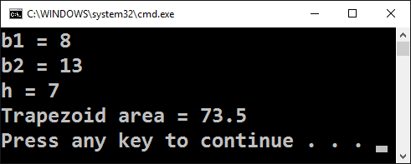
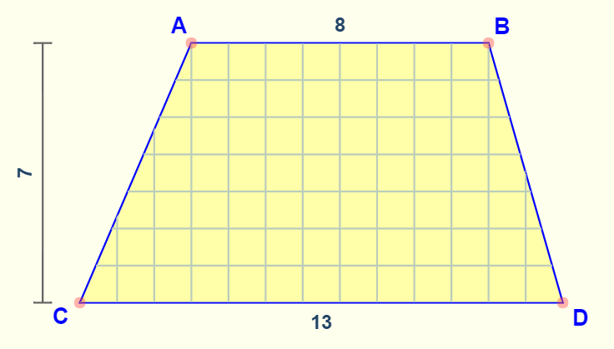
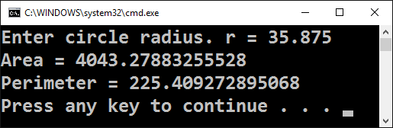
Areas and perimeters of figures
Work live in class (lab)

Slide 30
Perimeter and are of a circle
Write a program which receives the radius r of a circle and calculates its area and perimeter.
Area = π * r * r
Perimeter = 2 * π * r
π ≈ 3.14159265358979323846…
Console.Write("Enter circle radius. r = ");
var r = double.Parse(Console.ReadLine());
Console.WriteLine("Area = " + Math.PI * r * r);
Console.WriteLine("Perimeter = " + 2 * Math.PI * r);

Slide 31
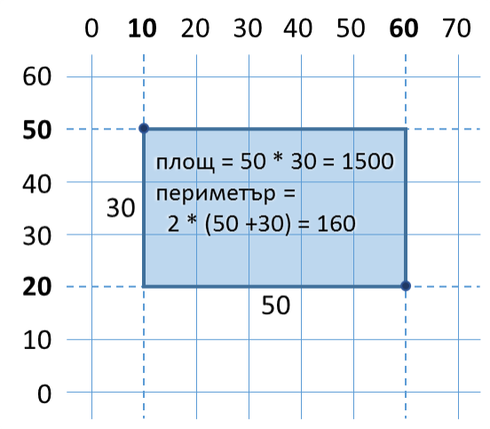
Area of a rectangle – example
Rectangle is given with its coordinates of two of its opposite corners
Calculate the area and the perimeter of the rectangle.

Slide 32
Area of a rectangle – solution
double x1 = double.Parse(Console.ReadLine());
double y1 = double.Parse(Console.ReadLine());
double x2 = double.Parse(Console.ReadLine());
double y2 = double.Parse(Console.ReadLine());
double width = Math.Max(x1, x2) - Math.Min(x1, x2);
double height = Math.Max(y1, y2) - Math.Min(y1, y2);
Console.WriteLine("Area = {0}", width * height);
Console.WriteLine("Perimeter = {0}", 2 * (width + height));
Test your solution: https://judge.softuni.bg/Contests/852/Variables-Data-Types-Expressions

Slide 33

Summary
Reading text
Reading an integer
Calculating numbers: +, -, *, /, ()
Formatting an output with placeholders/interpolation
var str = Console.ReadLine();
var num = int.Parse(Console.ReadLine());
var sum = 5 + 3;
Console.WriteLine("{0} + {1} = {2}", 3, 5, 3 + 5);

Slide 34







Variables, data types and expressions
https://softuni.bg/trainings/1764/fundamentals-of-programming-with-csharp

Slide 35
License
This course (slides, examples, demos, videos, homework, etc.) is licensed under the "Creative Commons Attribution-NonCommercial-ShareAlike 4.0 International" license

Slide 36





Trainings @ Software University (SoftUni)
Software University – High-Quality Education, Profession and Job for Software Developers
softuni.bg
Software University Foundation
http://softuni.foundation/
Software University @ Facebook
facebook.com/SoftwareUniversity
Software University Forums
forum.softuni.bg

